Slide 1
Real-Time Deepfake Image Detection Using Pretrained Xception CNN
Team Members
MUHAMMAD ASIF P A (230701199)
RAKESH R (230701257)
Mentor
R Bhuvaneswari

Slide 2






Introduction
Deepfakes are AI-generated fake images or videos that are
hard to detect.
These can spread fake news, cause identity theft, and disrupt
public trust.
Our system aims to catch fake images using a
pretrained deep learning model — Xception CNN.
It is fast, accurate, and easy to use through a web-based platform.
Allows to register complaint the cybercrime portal of India

Slide 3

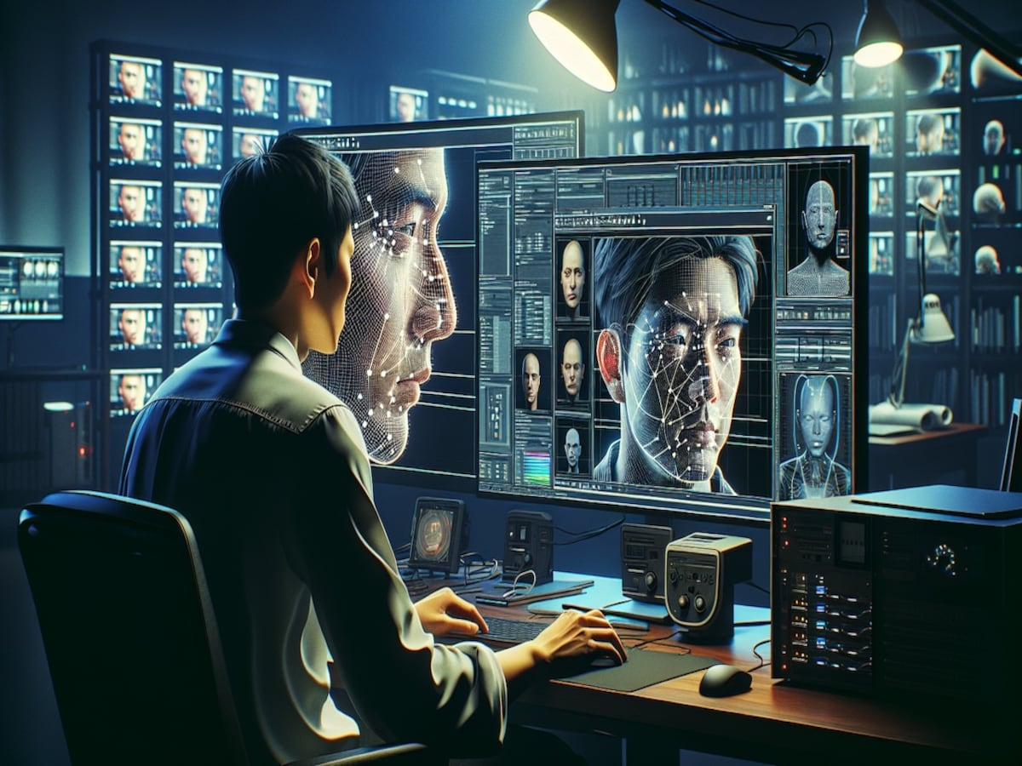
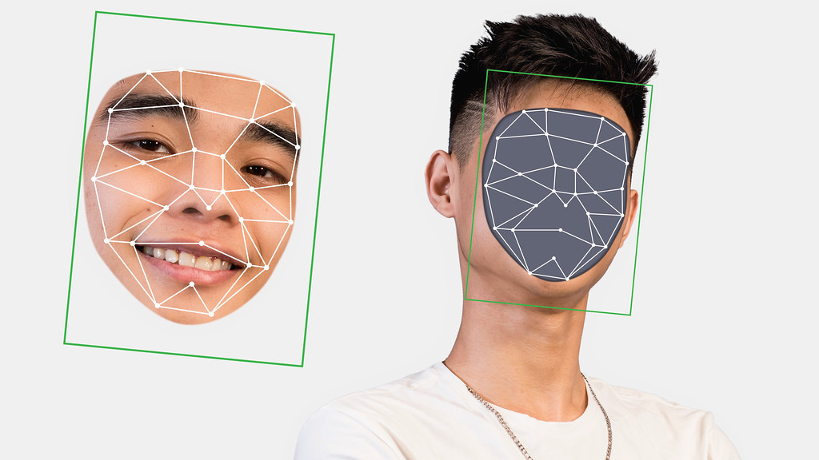
Problem Statement
Deepfakes are rising rapidly due to easy
access to generative tools like GANs.
There’s a lack of accessible, real-time
detection systems for images.
Existing tools are often complex, slow,
or inaccurate on low-res images.
There’s a need for a smart, fast, user-friendly
tool for early detection.

Slide 4





STANFORD DESIGN THINKING MODEL
Empathize: Identified risks of deepfakes on
media, law, and privacy
Define: Need a detection system that's easy
to use, accurate, and secure
Ideate: Explored pretrained models like
ResNet, VGG, EfficientNet
Prototype: Developed a React + Flask app
integrated with Xception model
Test: Achieved 98.2–99% accuracy on 200-image
dataset; real-time output

Slide 5





Features of the Project
Image upload and analysis in real-time
Xception CNN model detects fake vs real images
Firebase secure login for users
Cybercrime report button for suspicious images
Intuitive UI with color-coded result
display (green = real, red = fake)

Slide 6




Pain points Identified
Fake images causing legal and social harm
Lack of diversity in datasets affects accuracy
Difficulty in detecting low-resolution or
compressed deepfakes
Existing tools not user-friendly or real-time

Slide 7





Technologies Used
Frontend: React.js
Backend: Flask / FastAPI / Node.js
Model: Pretrained Xception CNN (from Kaggle)
Auth & Database: Firebase (Google Login)
Deployment: Web-based platform with real-time AP

Slide 8

Comparative Analysis of Existing system
Model | Accuracy | Strengths | Weaknesses
ResNet | 85% | Fast training | Less accurate
MobileNet | 91% | Lightweight | Less robust
Vision Trans. | 97% | Strong accuracy | Slower inference
Xception | 99% | High accuracy & speed | Slight drop on low-res

Slide 9


Proposed Method (Design Thinking Approach)
Problem empathy via real-world cybercrime concerns
Selected CNN-based solution for scalability & accuracy
Designed prototype with end-user ease in mind
Iterated with 10 model comparisons to select Xception
Implemented Google Auth and cybercrime reporting for trust

Slide 10




Proposed Method (Implementation / Prototype Developed)
Frontend: Image upload, status display, report button
Backend:
Loads image → Resizes → Normalizesa
Passes through pretrained Xception
Predicts (Real or Fake) → Sends response
Output: JSON returned → Color-coded UI display
Cybercrime Button: Redirects to reporting portal

Slide 11




Target Audience Benefitted
General social media users
Journalists and media verification teams
Law enforcement / Cybercrime investigators
Educational institutions (AI safety awareness)
Government organizations ensuring digital trust

Slide 12



Conclusion
Our system achieves 99% deepfake
detection accuracy using Xception CNN.
Provides fast, secure, and user-friendly web interface.
Future plans: improve on underrepresented
faces, better dataset, adversarial attack
resistance, and integrate with platforms
like Facebook or Twitter.
Strong step toward AI-powered digital trust and content verification.

